Slide 1

THE HISTORY AND SUCCESS OF “LEVIS” BY
ABHIMANYU SINGH (11800740)
A30
KOE32

Slide 2
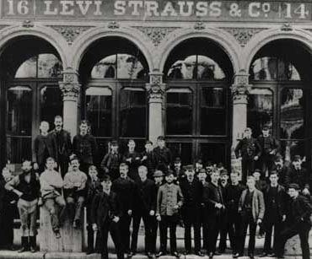
STORY OF YEAR - 1853
Levi Strauss & Co. is founded in San Francisco, CA.
After working with his brothers in their dry goods wholesale business in New York City, Levi emigrates to Gold Rush San Francisco. He opens his own dry goods business to serve the small general stores of the American West.

Slide 3
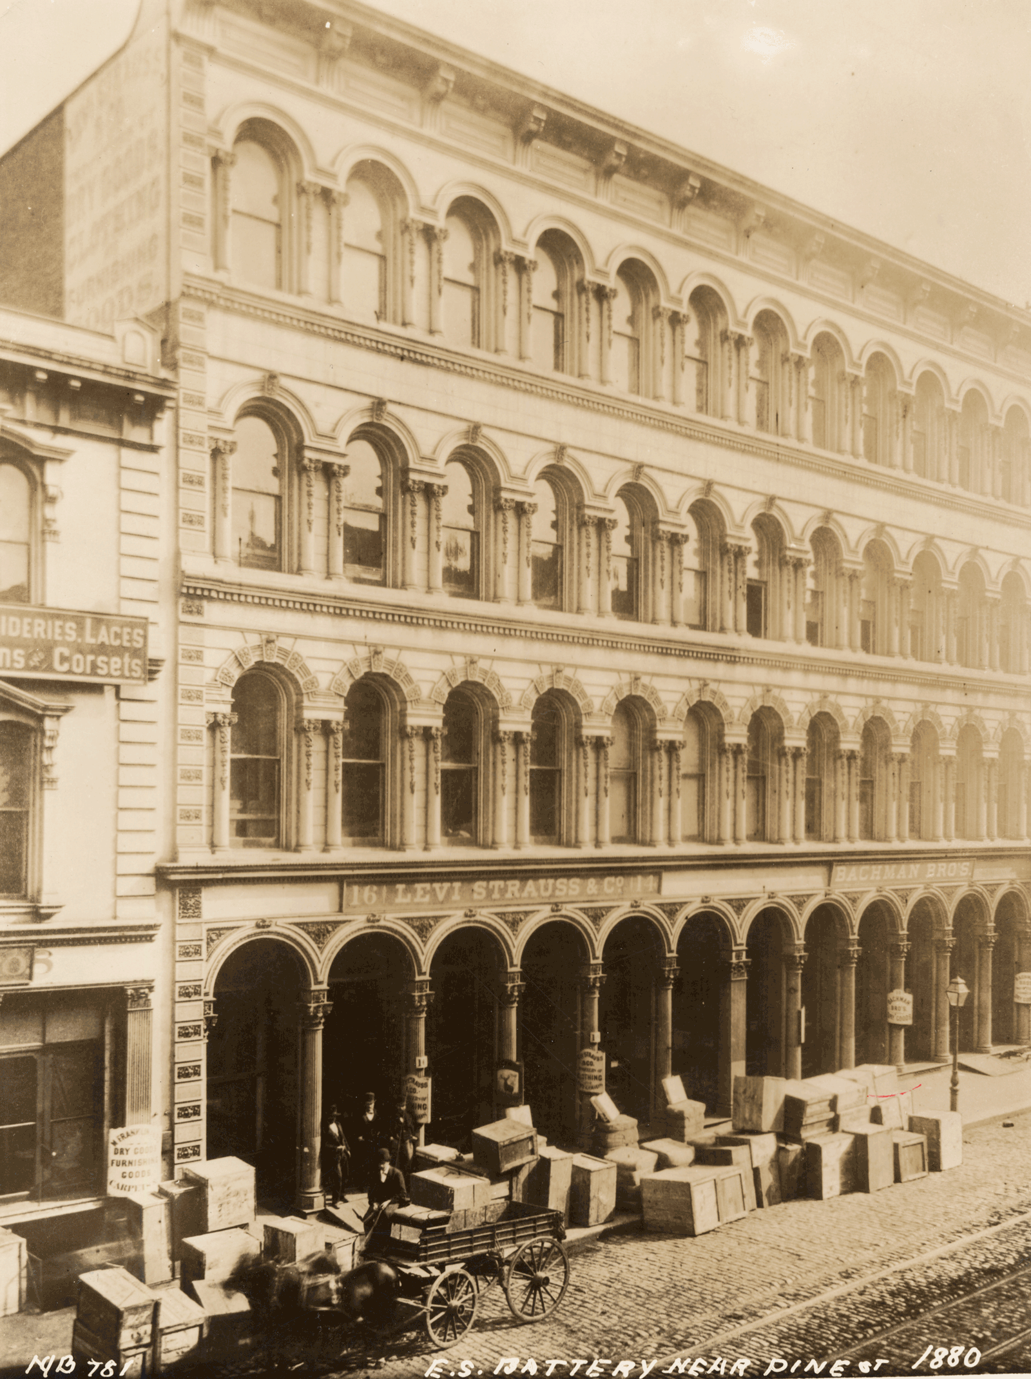
In the San Francisco Directory with Strauss serving as its sales manager and his brother-in-law, David Stern, as its manager. Jacob Davis, a Latvian-Jewish immigrant, was a Reno, Nevada tailor who frequently purchased bolts of cloth made from denim from Levi Strauss & Co.'s wholesale house.
After one of Davis' customers kept purchasing cloth to reinforce torn pants, he had an idea to use copper rivets to reinforce the points of strain, such as on the pocket corners and at the base of the button fly. Davis did not have the required money to purchase a patent, so he wrote to Strauss suggesting that they go into business together.

Slide 4
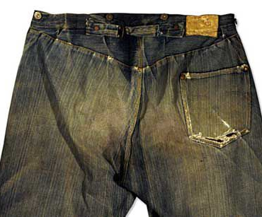
STORY OF YEAR - 1872
The Rivets
Jacob Davis, a tailor from Reno, Nevada, teams with Levi Strauss to create and patent work wear riveted-for-strength made of brown cotton duck and true blue denim.

Slide 5
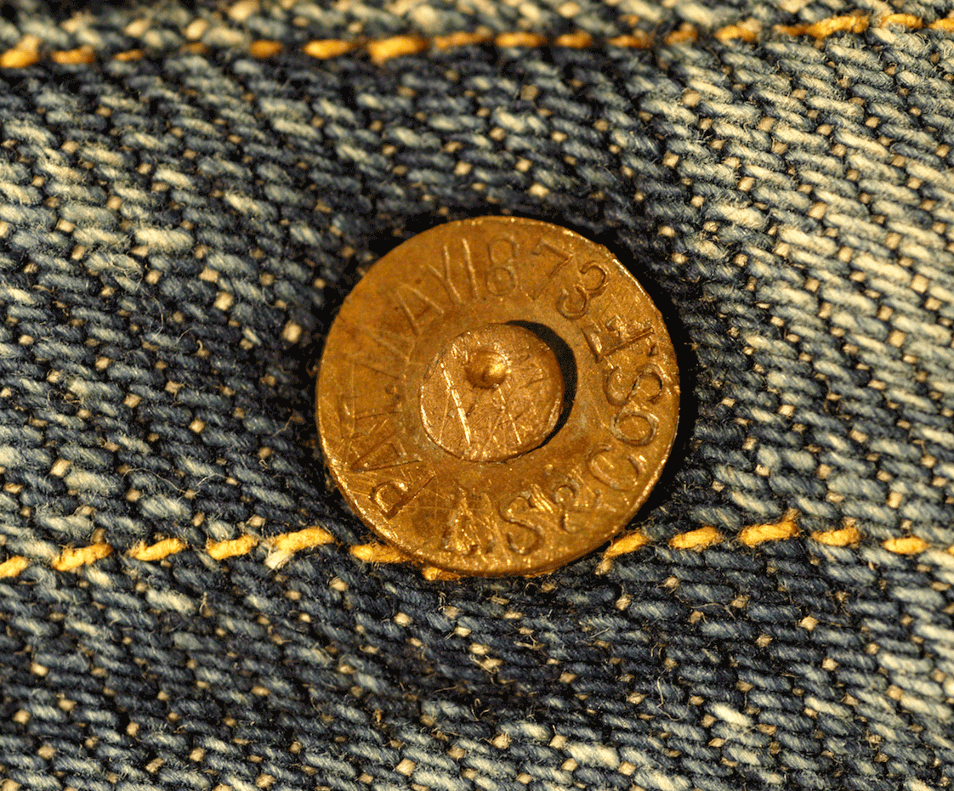
STORY OF YEAR - 1873
Blue Jeans Are Born.
Levi Strauss & Co. and Jacob Davis receive a U.S. patent for an - "Improvement in Fastening Pocket-Openings." By adding metal rivets to work pants, which would be known as blue jeans, they created stronger pants for working men.

Slide 6
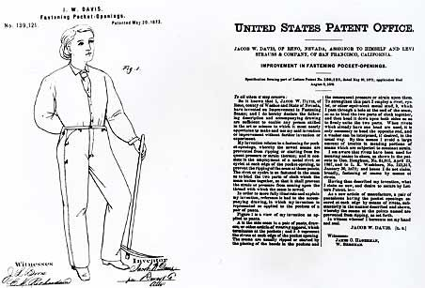
May 20, 1873 marked an historic day: the birth of the blue jean. It was on that day that Levi Strauss and Jacob Davis obtained a U.S. patent on the process of putting rivets in men’s work pants for the very first time.
Levi Strauss, a Bavarian-born dry goods merchant, came to San Francisco in 1853 at the age of 24 to open a West Coast branch of his brothers’ New York wholesale dry goods business. Over the next 20 years, he built his business into a very successful operation, making a name for himself not only as a well-respected businessman, but also as a local philanthropist. One of Levi’s customers was a tailor named Jacob Davis.
One day the wife of a local laborer asked Jacob to make a pair of pants for her husband that wouldn’t fall apart. Jacob tried to think of a way to strengthen his trousers and came up with the idea to put metal rivets at points of strain, like pocket corners and the base of the button fly. These riveted pants were an instant hit. Jacob quickly decided to take out a patent on the process, but needed a business partner to help get the project rolling. He immediately thought of Levi Strauss, from whom he had purchased the cloth to make his riveted pants.

Slide 7
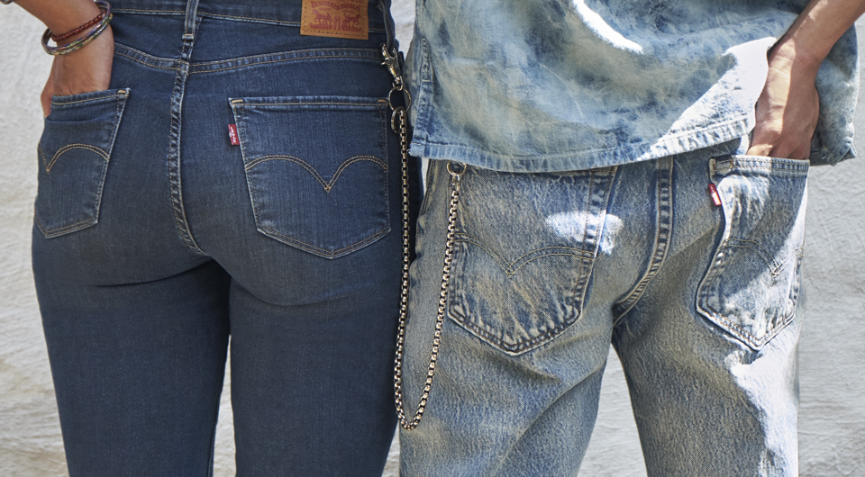
Davis wrote to Levi to suggest that the two men hold the patent together. Levi, being an astute businessman, saw the potential for this new product, and agreed to Jacob’s proposal. The two men received patent #139,121 from the U.S. Patent and Trademark Office on May 20, 1873.
Soon, the first riveted clothing was made and sold. We made our first jeans out of denim — the traditional fabric for men’s workwear. Within a very short time, the jean was a bona fide success. (Although, we should note that they were called “waist overalls” or “overalls” until 1960, when baby boomers adopted the name “jeans.”)
We consider May 20, 1873 the “birthday” of blue jeans, because although denim pants had been around as workwear for many years, it was the act of placing rivets in these traditional pants for the first time that created what we now call jeans.
The next time you see someone wearing a pair of Levi’s® jeans, remember that these pants are a direct descendant of that first pair made back in 1873. That year, two visionary immigrants — Levi Strauss and Jacob Davis — turned denim, thread and a little metal into what has become the most popular apparel on earth.

Slide 8
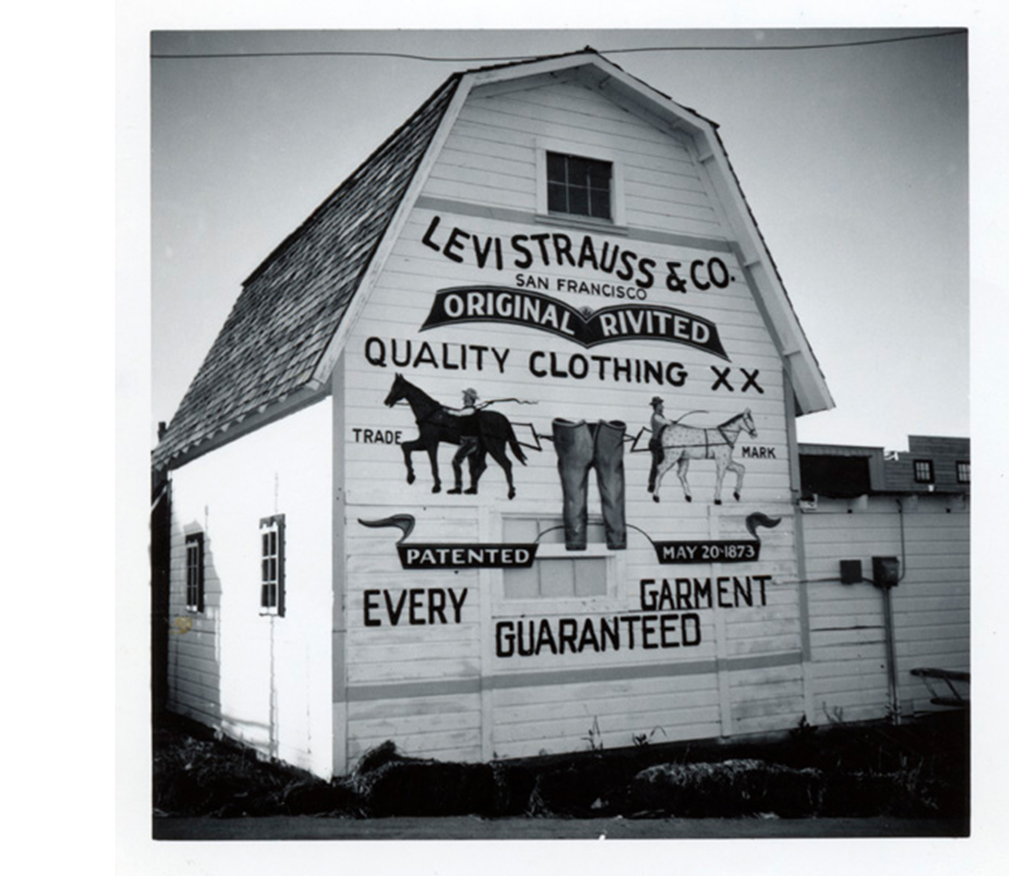
STORY OF YEAR - 1886
Introducing the Two Horse Trademark.
The Two Horse Trademark depicts two horses attempting to pull apart a pair of Levi's® waist overalls. The logo symbolized the strength of the clothing in the face of competition.

Slide 9
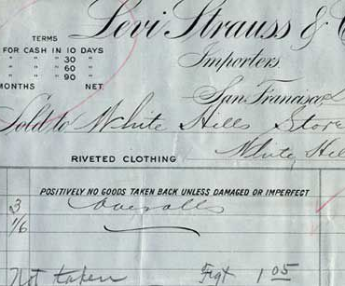
STORY OF YEAR - 1890
From Double X to Five Oh One.
The original “XX” blue jean is given its iconic lot number 501®.

Slide 10
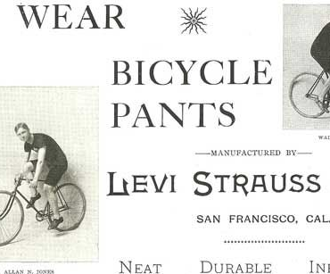
STORY OF YEAR - 1895
Performance Gear.
Levi Strauss & Co. introduces its first bicycle pants.
It only takes another 116 years for us to come out with Levi’s® Commuter, a multi-functional performance product designed for the modern cyclist.

Slide 11

STORY OF YEAR - 1934
Introducing Lady Levi’s®.
Levi Strauss & Co. introduced the first blue jeans for women.
They Called Them “Lady Levi’s®”
The first jeans for women, Lady Levi’s® are made of pre-shrunk denim and constructed with many of the same features of the men’s 501® jeans. They owe their feminine allure to a fashionably high, nipped in waist.

Slide 12
It may seem like a simple contribution in the larger journey toward gender equality, but Levi’s® truly pushed the envelope when it created the first-ever line of jeans for women back in 1934.
Western women had been borrowing their husband’s or brother’s Levi’s® 501® jeans for years when LS&Co. recognized the need for a women’s work pant. While the concept of Lady Levi’s® was born out of need, it was completely cutting-edge when you consider the fact that women’s pants were not accepted as mainstream dress until several decades later.
“Women wearing pants — especially denim Levi’s® — was considered inappropriate and unacceptable in the 1930s and most of the 1940s with few exceptions,” said LS&Co. Historian Tracey Panek. “Independent-minded Western women and others who first donned jeans might even be considered a bit edgy.”
Known as Lot 701, Lady Levi’s® sent a powerful message early on that Levi Strauss & Co. championed women and their ability to do “men’s work.” Back in the 1930s, women simply did not wear denim in public. Jeans were for men — laborers, specifically — and class and cultural distinctions were extremely rigid at that point in time.

Slide 13
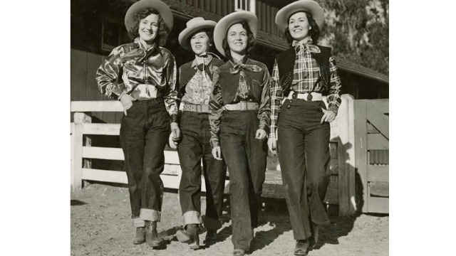
Not only that, Lady Levi’s® jeans had a button fly. This was truly subversive; even pants with a front zipper were considered a little daring, but to wear button-fly pants was a way of taking a step away from conformity.
Lady Levi’s® became wildly popular during the heyday of dude ranches. While most ranches were in the West, jeans were sold as far away as New York so visitors could outfit themselves before they arrived at the ranch. But make no mistake, the jeans were more than a fashion statement — they were a political one as well.
As we commemorate International Women’s Day today — aimed at celebrating the social, economic, cultural and political achievements of women — we’re also giving back by offering a 2-for-1 match for any LS&Co. employee who donates to an organization focused on women’s health and equality through the end of March. We laud the role Levi’s® played in giving women the ability to physically express themselves as they saw (comfortably) fit.

Slide 14
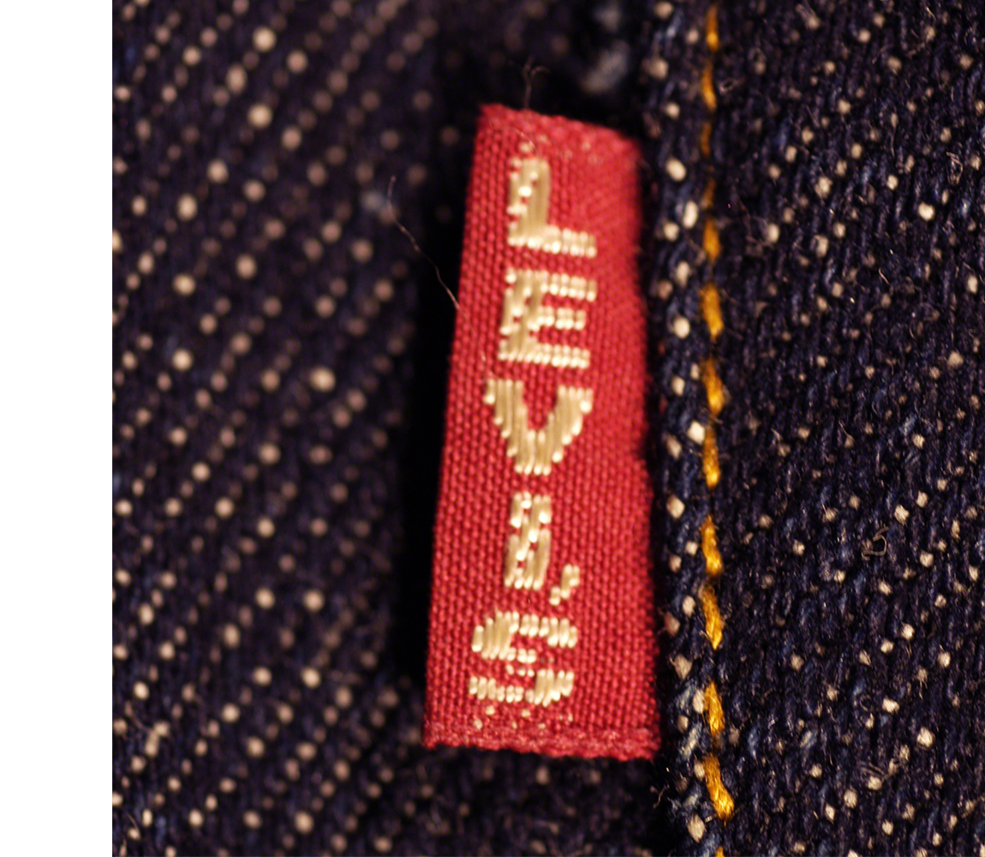
STORY OF YEAR - 1936
The First Use of Red Tab.
In order to differentiate our products from competitors, the Red Tab is added to the right back pocket of the 501® jean, where it is still placed today.

Slide 15
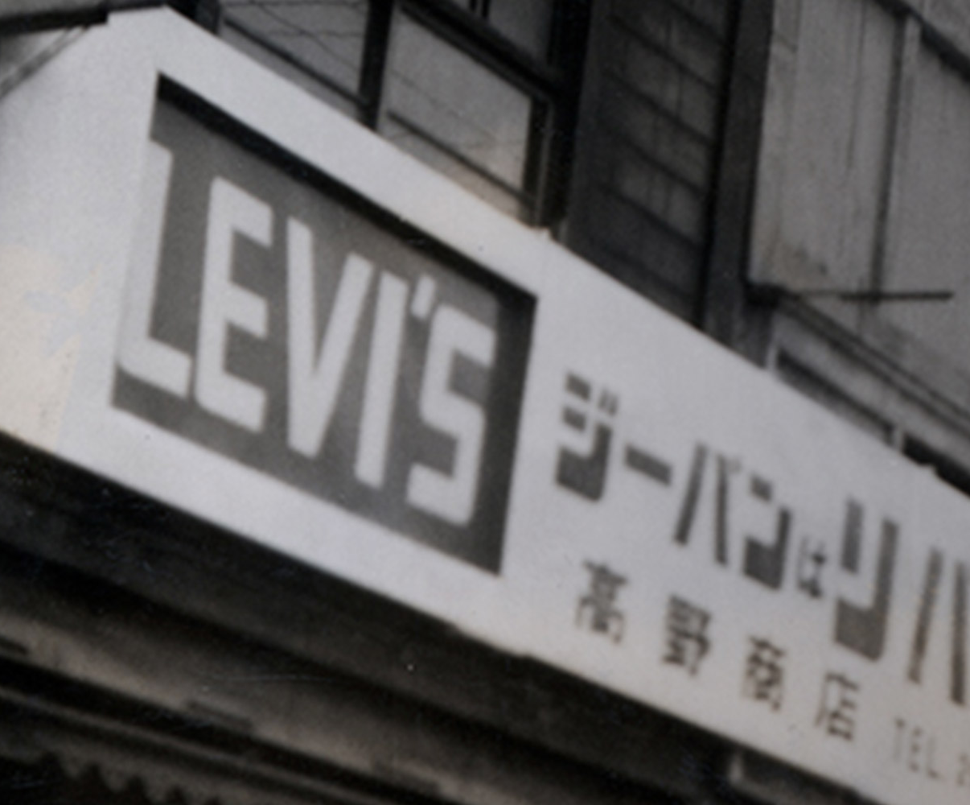
STORY OF YEAR - 1965
International Division is Formed.
By the 1960s, the popularity of jeans, jackets and other Levi’s® products lead the company to set up offices and factories throughout Europe and Asia.

Slide 16
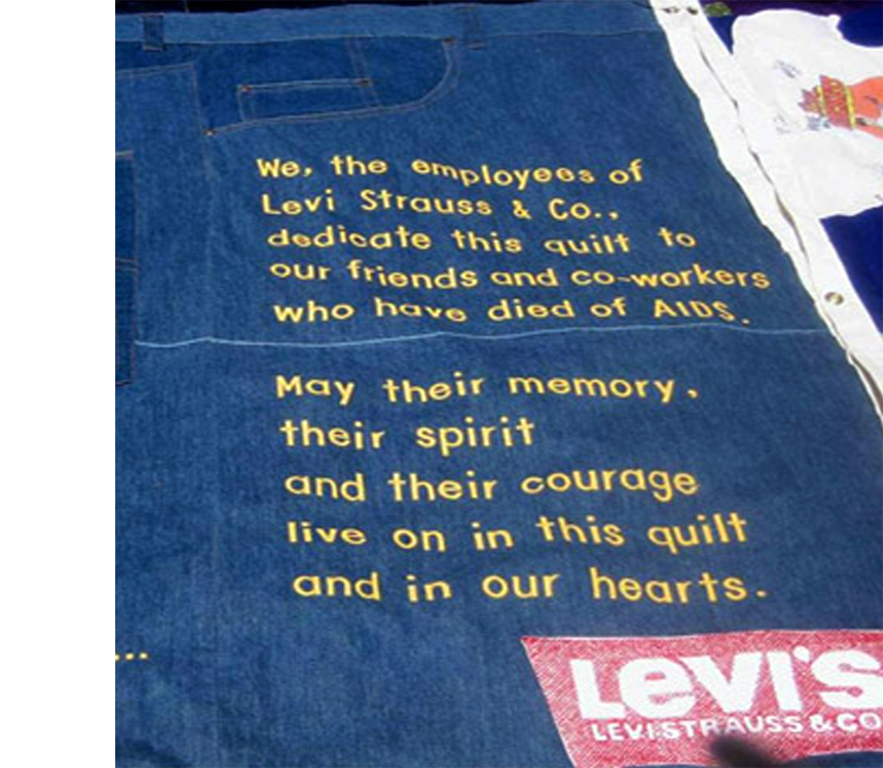
STORY OF YEAR - 1965
1982 - LS&Co. Responds to the Growing AIDS Crisis
Employee donations at the Kaposi Sarcoma clinic at San Francisco General Hospital are matched by the Levi Strauss Foundation. The following year, support groups for HIV+ employees are formed at our headquarters.

Slide 17

STORY OF YEAR - 1986
Dockers® Launches.
Dockers® khakis revolutionize business attire when young professionals adopt khakis as their pant of choice and lead the charge in making casual wear appropriate attire for the workplace.

Slide 18
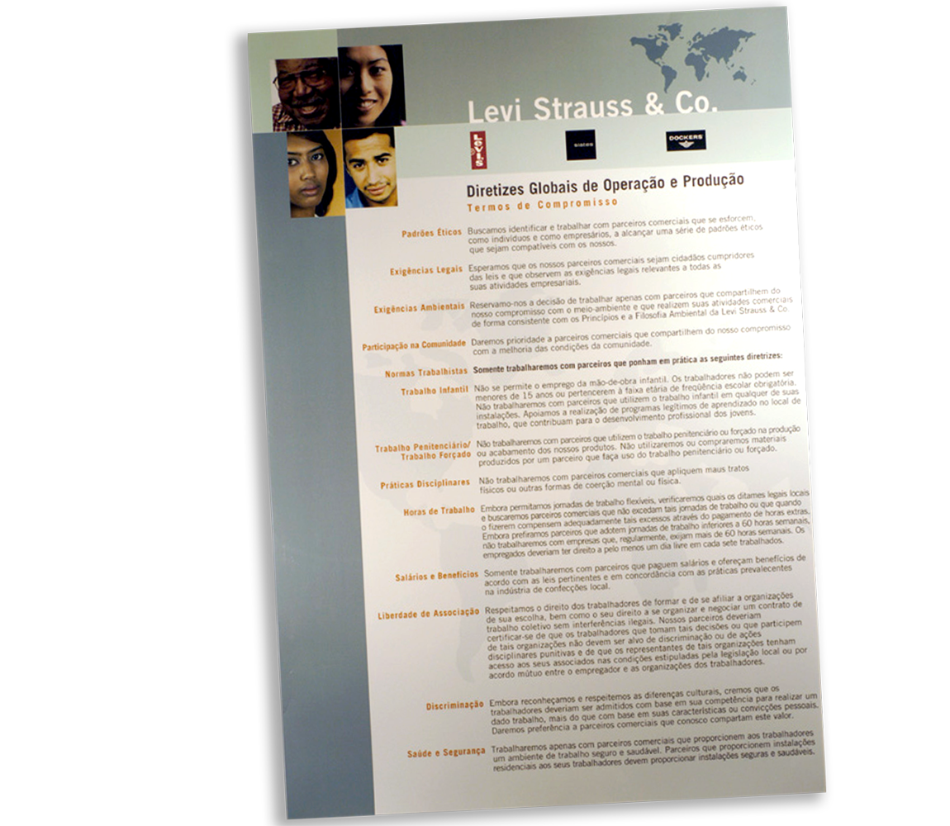
STORY OF YEAR - 1991
T.O.E Established. We are the first multinational apparel company to launch a comprehensive code of conduct for all contract factories and licensees. The Terms of Engagement set out ethical standards, legal and environmental requirements, community involvement and standards to address child and forced labor, disciplinary practices, working hours, wages and benefits, freedom of association, discrimination, and health and safety.

Slide 19
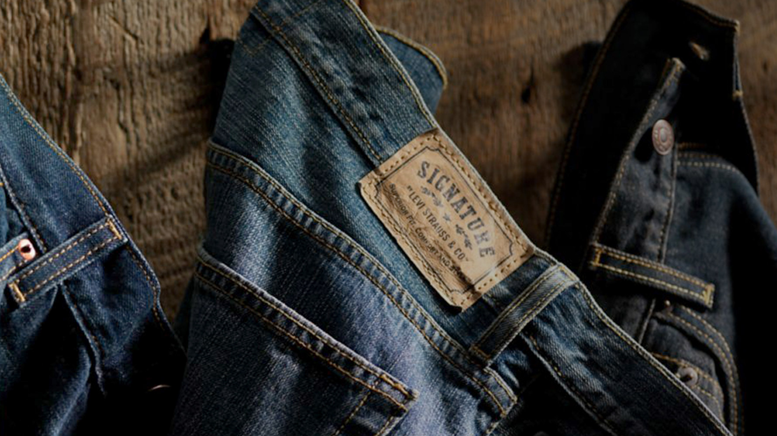
STORY OF YEAR - 2003
Levi Strauss Signature Launches.
Known today as Signature by Levi Strauss & Co.™, the brand serves shoppers at mass-channel retail stores, giving value-oriented consumers access to products from a company with a heritage of high-quality Jeanswear.

Slide 20
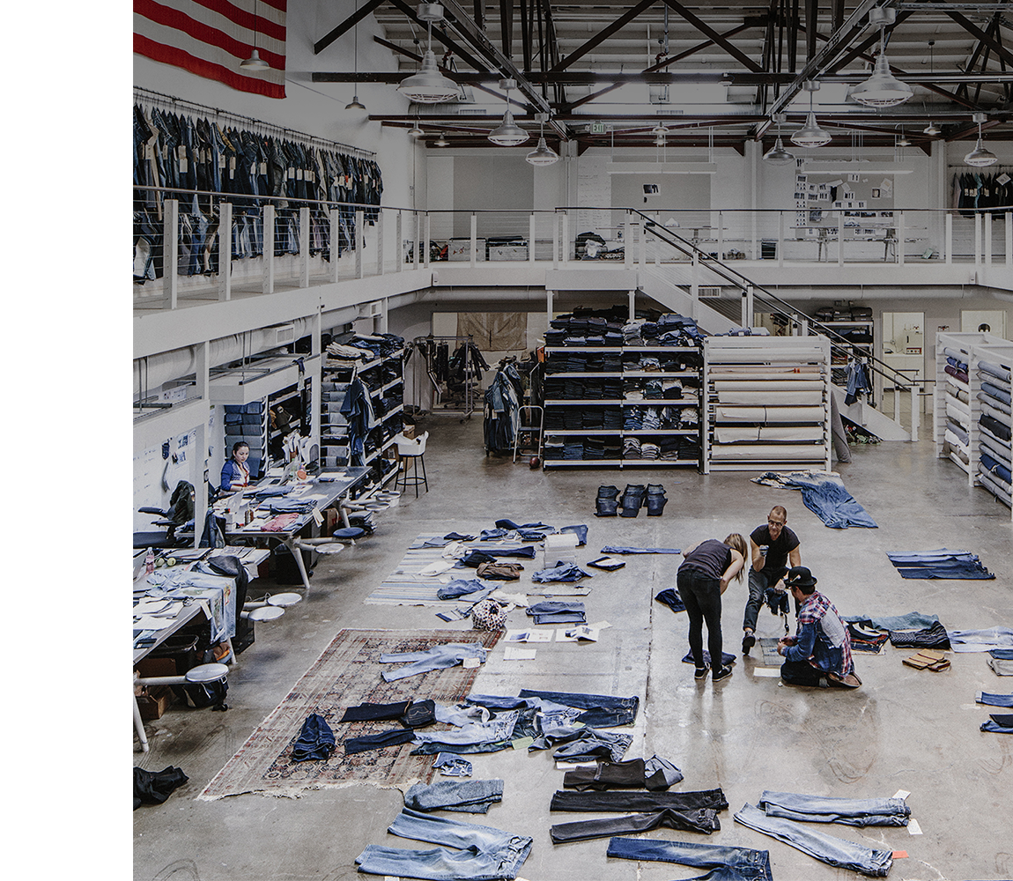
STORY OF YEAR - 2013
Our Eureka Innovation Lab Opens.
The innovation lab is a research and development facility dedicated to design ideation and prototyping.

Slide 21

STORY OF YEAR - 2015
We Launch Our Screened Chemistry Program.
The industry-leading program examines the health and environmental impacts of chemicals to identify safer alternatives and areas for innovation.

Slide 22
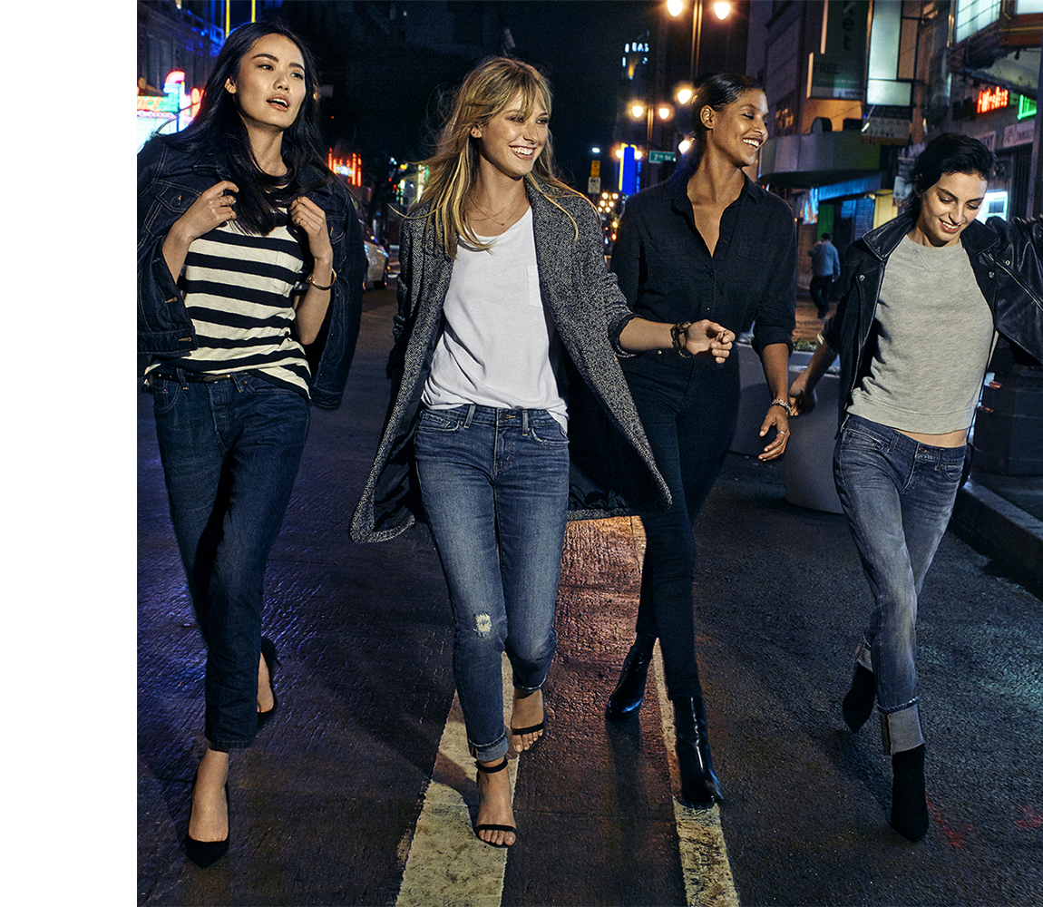
STORY OF YEAR - 2015
Levi’s® New Women’s Denim Collection Launches Globally
The 700 series is inspired by the original 1934 women’s blue jeans Lot 701. The pants include additional stretch along with authentic elements like the Two-Horse Design patch.

Slide 23
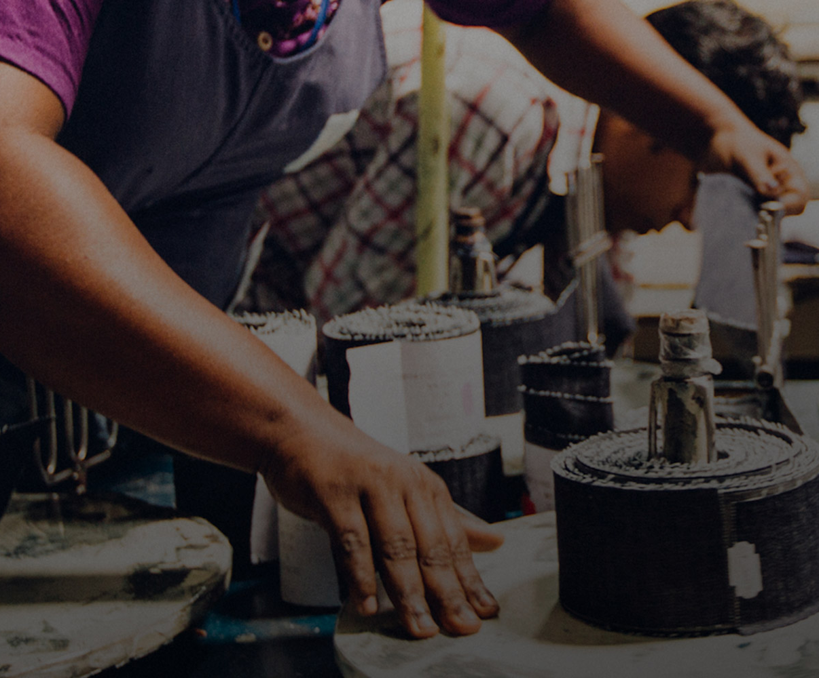
STORY OF YEAR - 2016
We Open Source Pioneering Programs
We opened up our Screened Chemistry, Water<Less® and Worker Well-being programs to the greater industry in hopes of making a greater impact on the planet and those who work in the apparel supply chain.

Slide 24
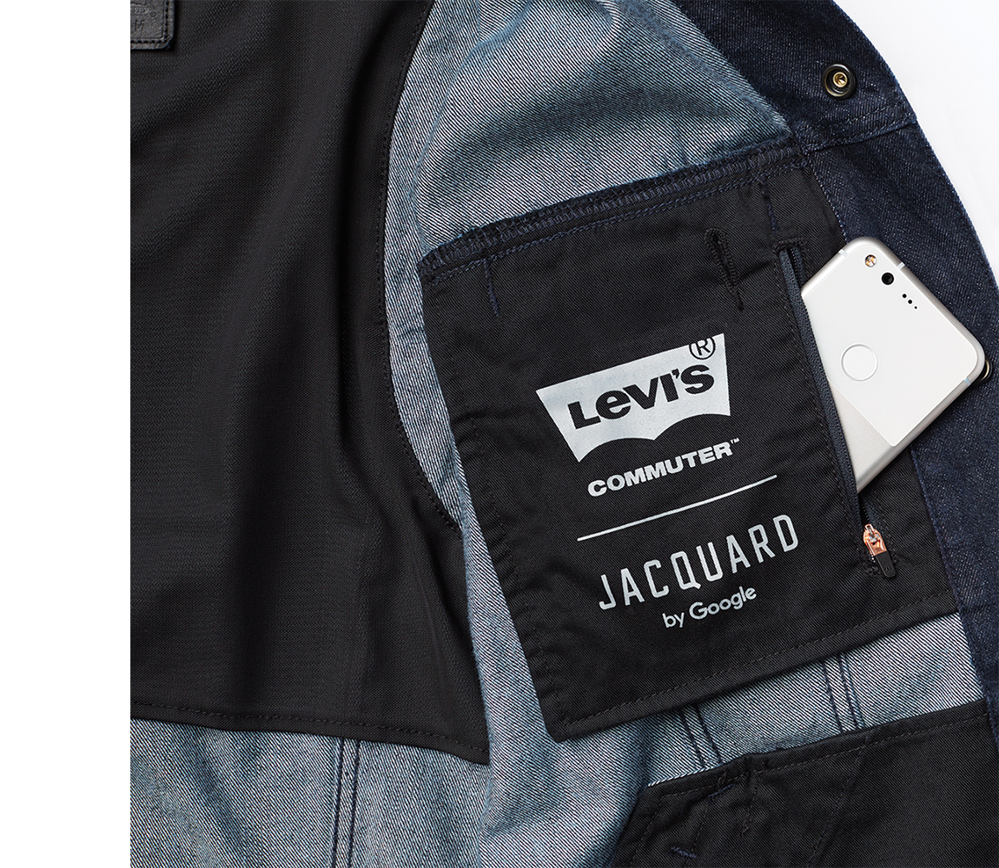
STORY OF YEAR - 2017
The Levi’s® Commuter™ Trucker Jacket With Jacquard™ Debuts
Designed for the urban commuter, Jacquard technology woven into this Levi’s® jacket lets you access your music, navigation and communications such as texts and calls with the swipe of your sleeve.

Slide 25
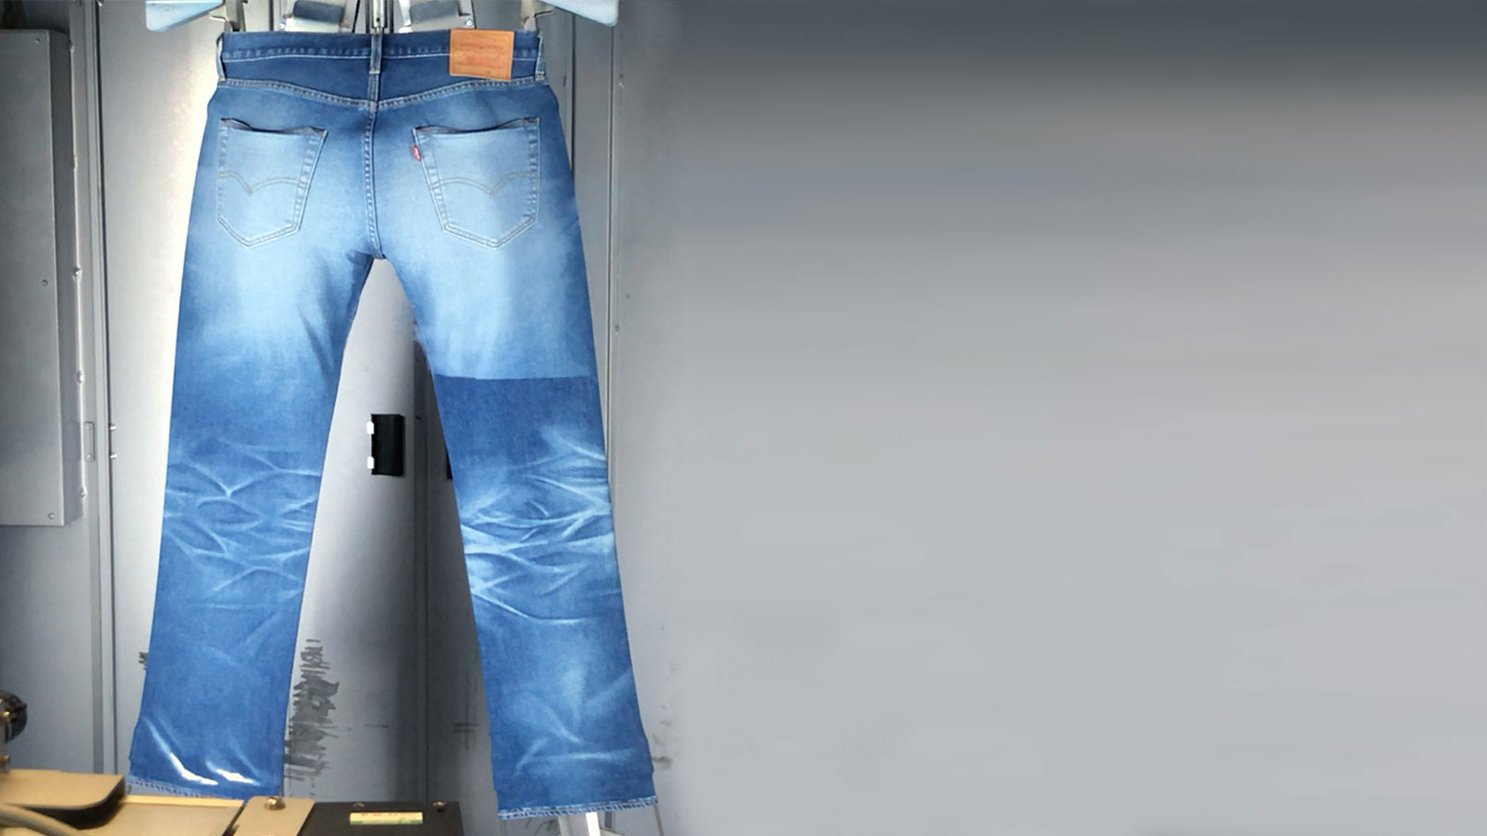
STORY OF YEAR - 2018
Levi Strauss & Co. introduces Project F.L.X.
Project F.L.X. digitizes denim finish design and development, and enables a responsive and sustainable supply chain at an unparalleled scale.

Slide 26
THANK YOU

